Slide 1

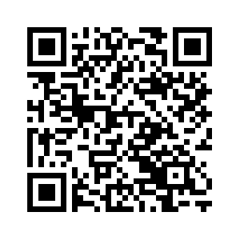



One off personal health budgets for mental health
Open to all inpatients and can be used to:
Support a social need
Signpost to additional support
Support on social discharge
Any questions, email us at: personalhealthbudgets@bdct.nhs.uk

